Slide 1
Tremaux(Maze analysing)Algorithm
Roll.no:02
Roll.no:09
Roll.no:
Roll.no:

Slide 2
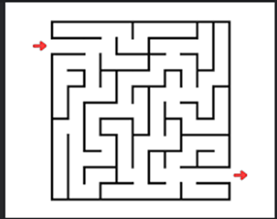
Introduction
Maze:A maze is a type of puzzle involving a collection of paths, usually where a player has to find a route from start to finish

Slide 3
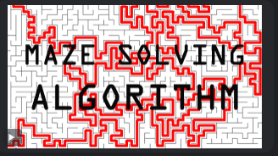
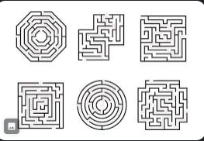
Mazes are of various shapes, kinds and difficulties
A huge variety of algorithms exist for generating and solving mazes. These are not only fun to implement, but also are a good way to familiarize yourself with programming techniques, algorithms, and languages.

Slide 4
How was this made
Tremaux's algorithm, invented by Charles Pierre Tremaux, Basically, it draws lines on the floor to mark a path, and is guaranteed to work for all mazes that have well-defined passages. Decision is made by decision parameter when a path is either unvisited, marked once or marked twice.

Slide 5
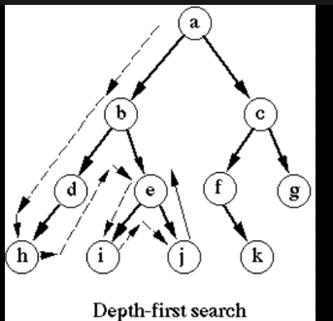
It uses the Depth-First Search algorithm, which allows it to find a way out of the maze, only this algorithm is not guaranteed to have the shortest route solution.

Slide 6
It Uses various DATA STRUCTURE concepts like using ‘ABSTRACT DATA TYPE’ such as ‘Graphs’ and ‘Trees’ and Traversing technique to traverse through graph and trees
References :
1) Wikipedia
2)Researched Docs of foreign universities

Slide 7

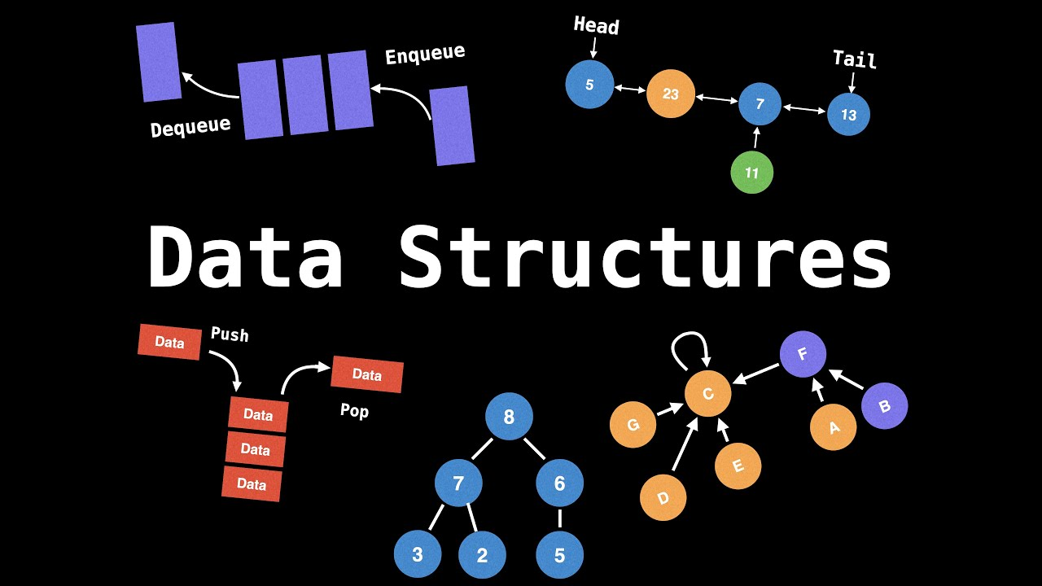
Motivation
A Maze solving algorithm is a stimulating intellectual challenge, requiring creative problem-solving and algorithmic thinking. Maze-solving algorithms have practical applications in robotics, navigation, and game development, making it a valuable skill to have. A maze-solving program can be a stepping stone to more complex projects in the fields of artificial intelligence or robotics.
This algorithm requires having prerequisite knowledge in data structures and programming languages which can help enhance our knowledge and skill.

Slide 8
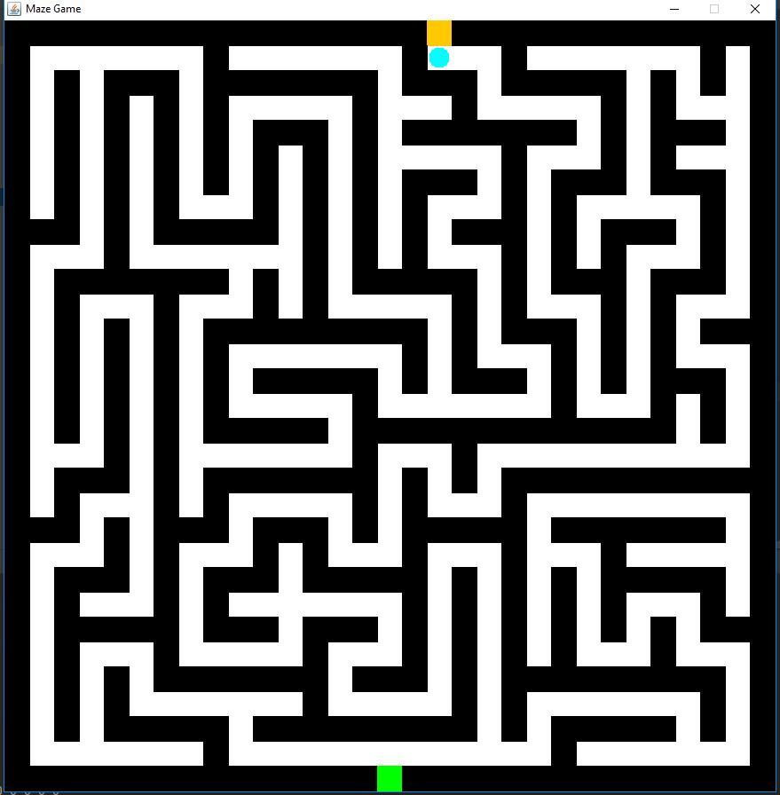
Another approach that can also be taken (to avoid Unity) is by making use of JavaFX package which could provide an interactive demonstration of the maze generation and solution.

Slide 9
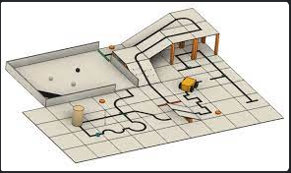
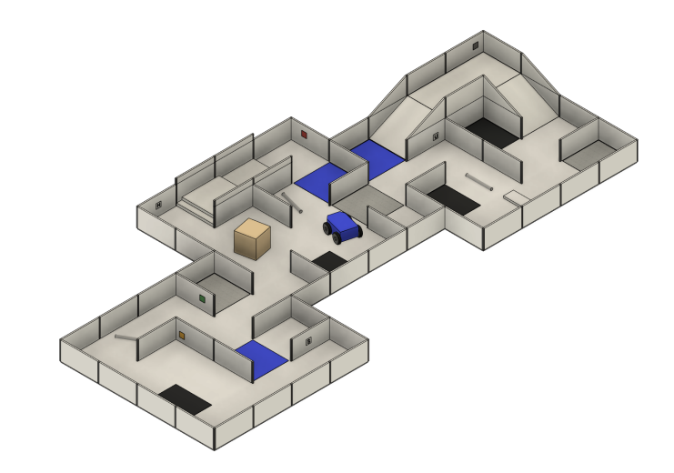
Scope
It can be used in Rescue Operation during calamities, as it might be dangerous for rescue teams to enter.

Slide 10
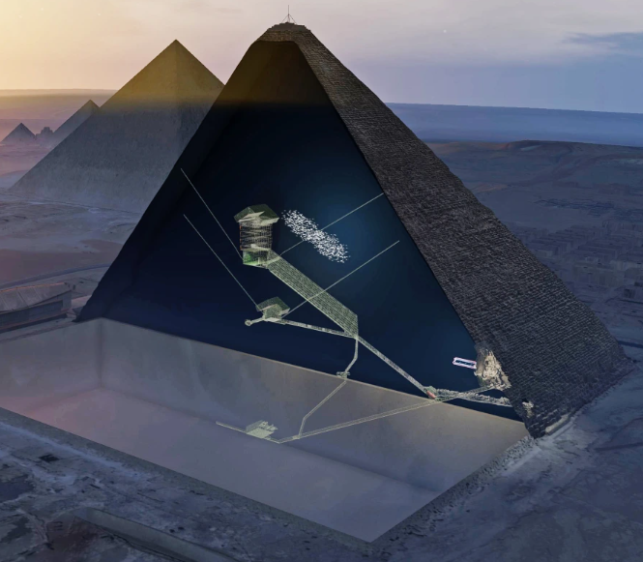
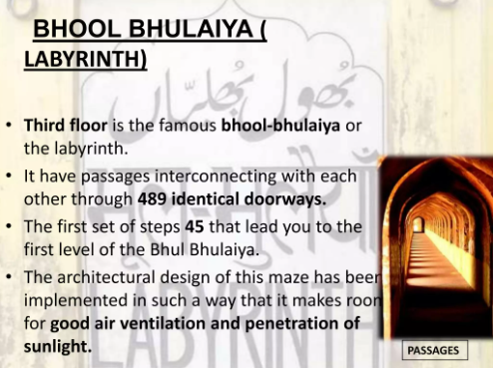
It can be used in archeological sites like pyramids or caves where it might be dangerous for human to enter due traps, fragile structures and the threat of getting lost.

Slide 11
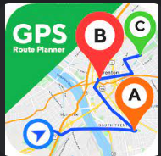
It can used by ambulances, delivery apps and vehicles, traffic control apps to find best and fastest routes to the destination.

Slide 12
Thank you

